Slide 1
.Net Maui Collections View

Slide 2
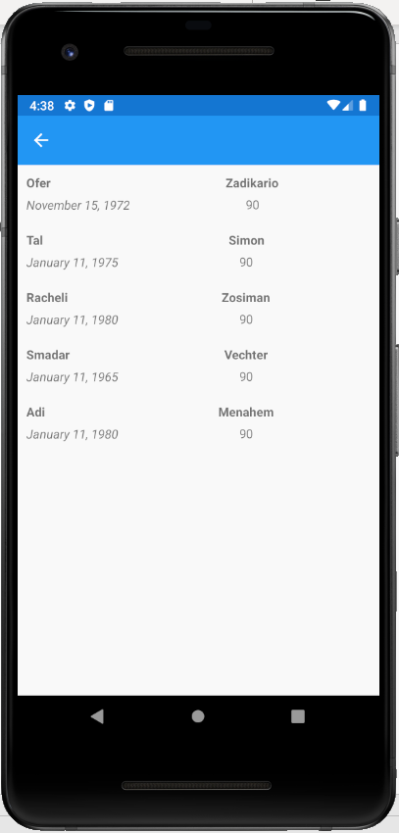
Collection View
Sometimes we want to display a list of items on the screen that are based on a list of objects. For example, a list links to news articles, list of contacts, list of pictures, etc… Collection view was made especially for such cases!

Slide 3
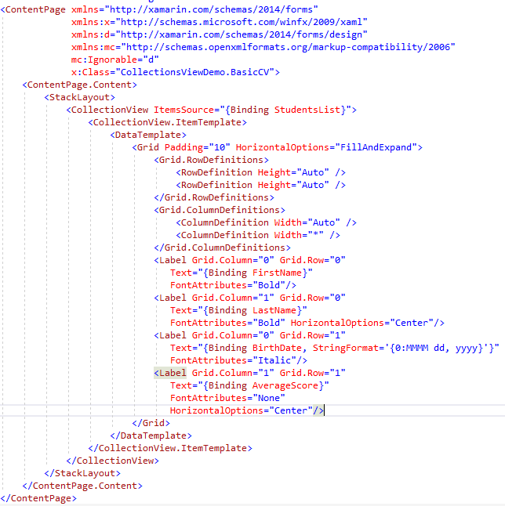
Basic Collection View
The Concept of ViewModel (in short)
The ItemSource property
The DataTemplate of Item

Slide 4
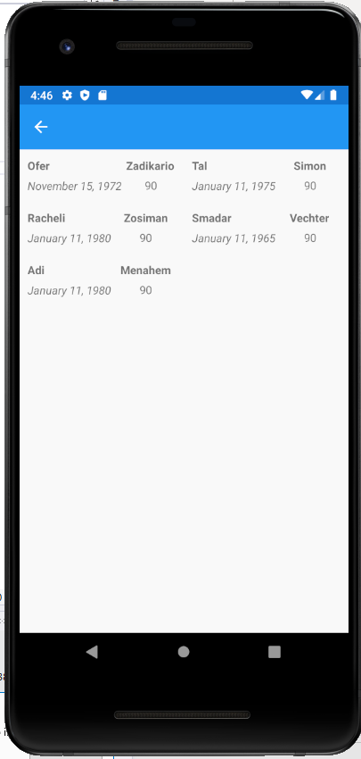
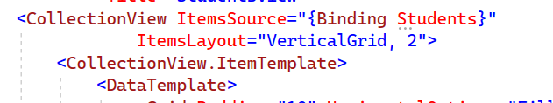
Item Layout
ItemsLayout property
Orientation and Span properties inside the GridItemsLayout

Slide 5
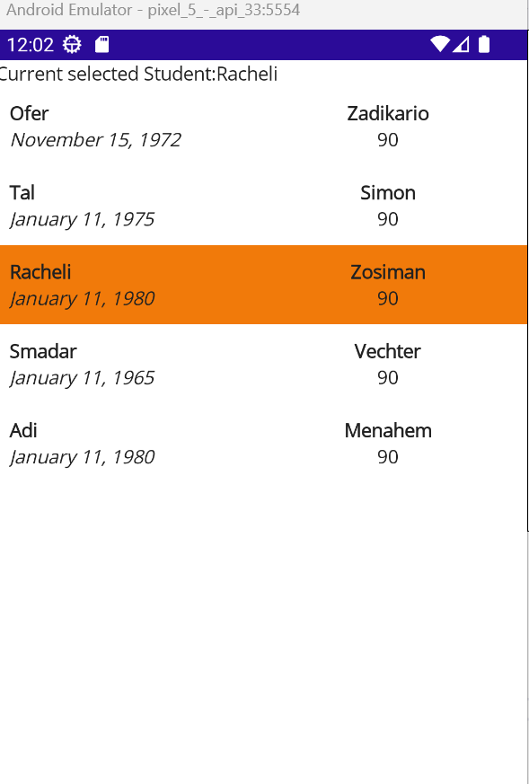
Selection Mode
Selection Mode property
SelectionChanged Command

Slide 6
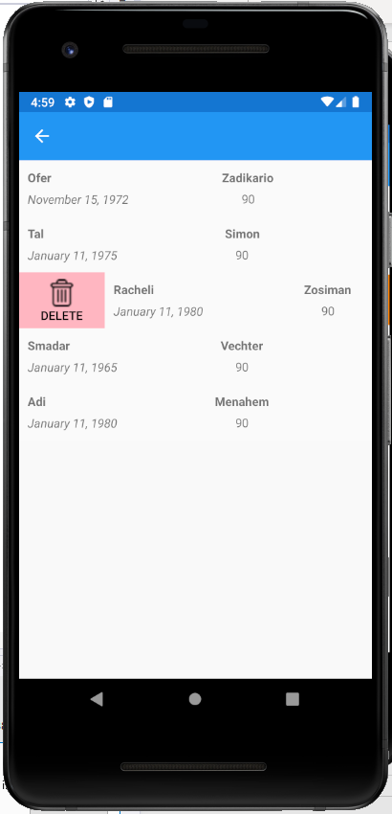
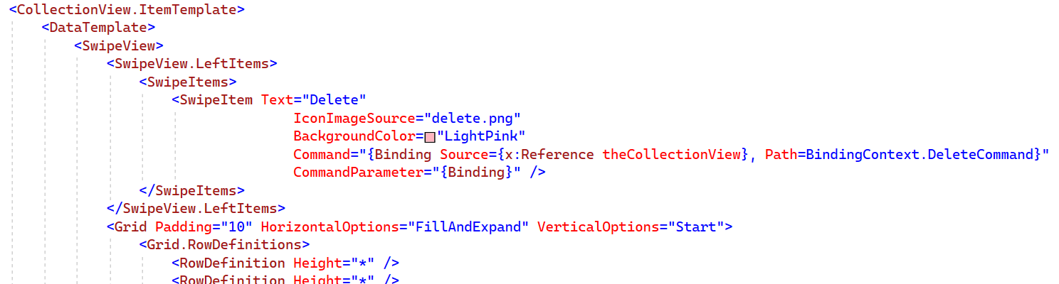
Context Menu
Swipe View, Left/Right Items, Swipe Item properties
Icon must be in Images folder
Command and Command Parameter with Data binding!

Slide 7
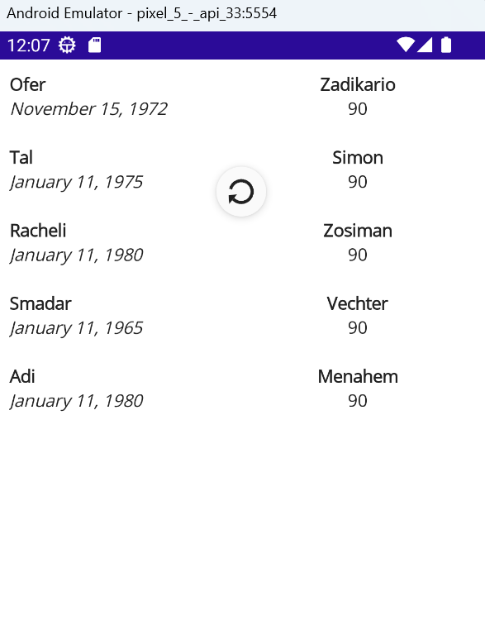
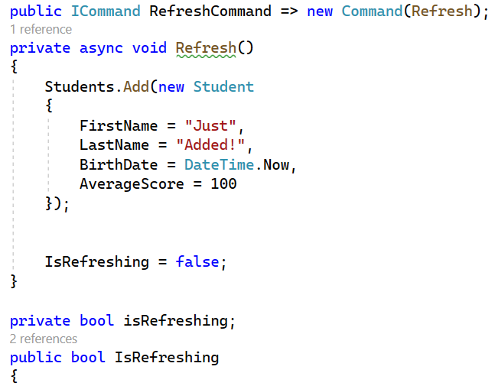
Refresh View
Refresh View Class
Command property and implementation

Slide 8
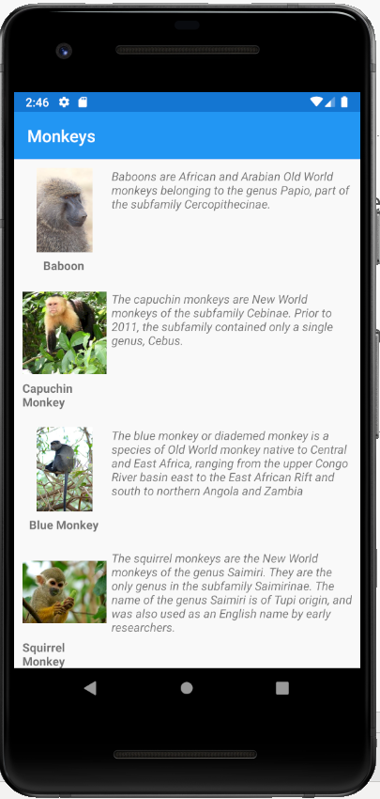
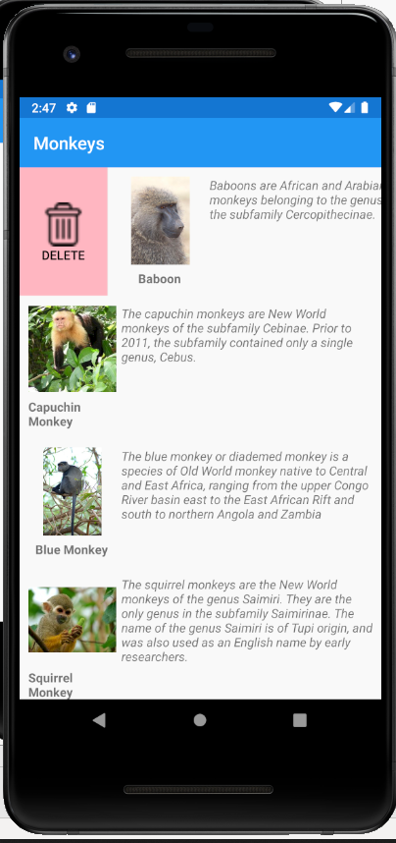
Exercise
Write an application that shows a list of monkeys.
On swipe right – a delete button appears. Click on this button deletes the monkey from the list.
On Swipe down – a refresh happens and all monkeys are loaded back (also those that you have deleted before)

Slide 9
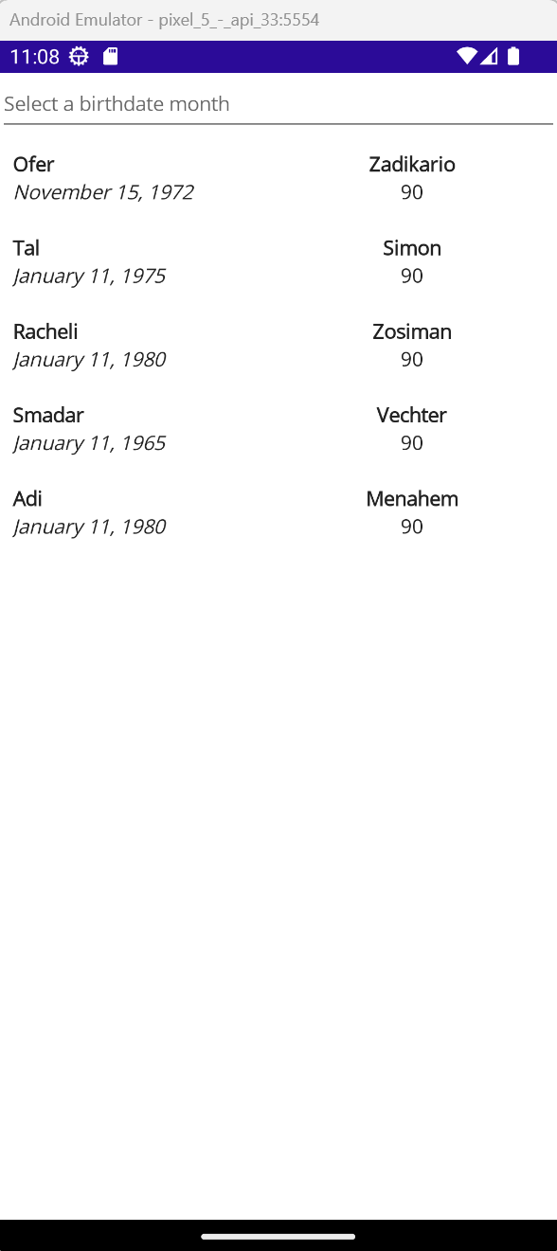
Picker
Picker is a drop down control that allow the user to pick a value out of a list of values. Each presented value is attached to a specific object in the list!

Slide 10
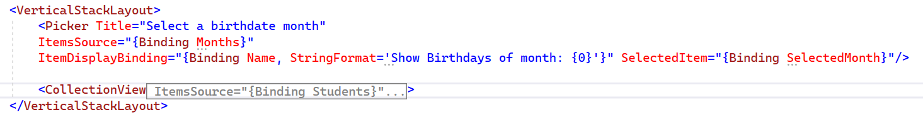
Picker

Slide 11
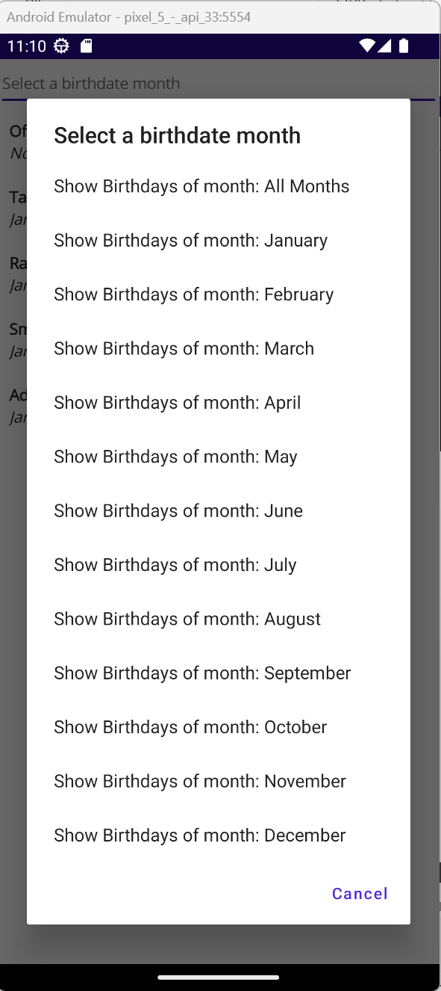
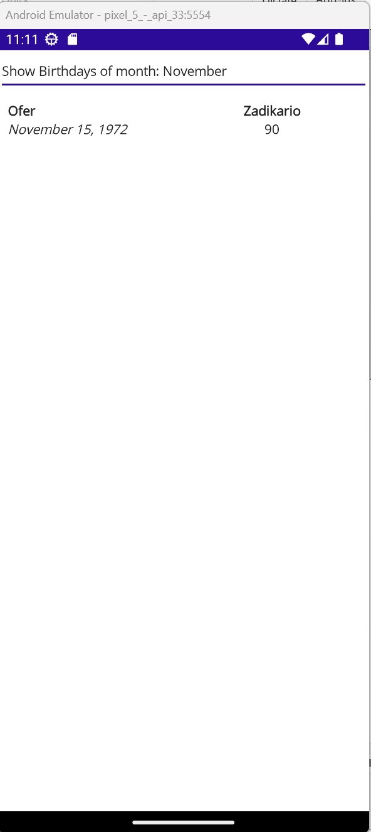
Picker

Slide 12
Exercise2
Add to the top of the previous exercise page – a Picker that will show all monkeys locations (one for each location!)
Upon Selecting a specific location – the page will show only monkeys from the selected location!

